Slide 1
Works
1
Grad-CAM (Gradient-weighted Class Activation Mapping)
2
Finish SimCLR training on TCGACOAD tumor patches
3
AttMIL & TransMIL are trained by pretrained CNN, SimCLR features
KRAS, BRAF mutation prediction
MSI prediction

Slide 2
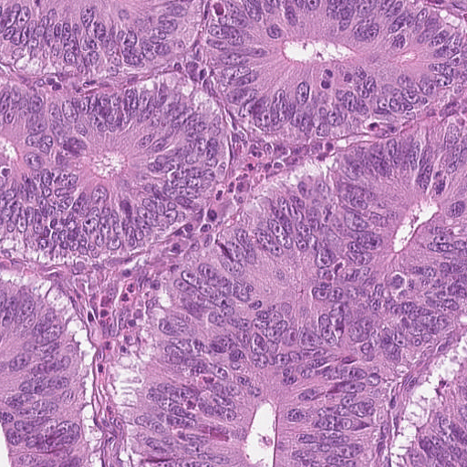
Grad-CAM (Gradient-weighted Class Activation Mapping)
Grad-CAM is a visual explanations techniques for decisions from a large class of CNN-based models, making them more transparent.
Why we need Grad-CAM (Explainable AI)?
1
When an AI model has high performance, explainable AI can demonstrate its persuasiveness, helping humans build confidence in using it.
This is tumor!
Deep learning model
Because…

Slide 3
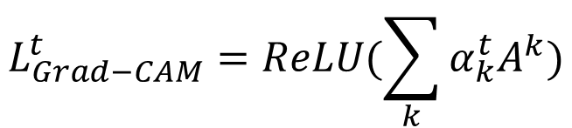

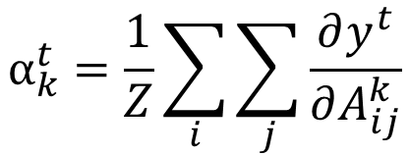



Forward
$$A^{1}$$
Feature extractor
GAP
FC
tumor
.…
……
non-tumor
(ResNet101)
$$A^{k}$$
$$α_{k}^{t}=\frac{1}{Z}\sum_{i}{\sum_{j}{\frac{∂y^{t}}{∂A_{ij}^{k}}}}$$
$$α^{1}$$
.…
$$L_{Grad−CAM}^{t}=ReLU(\sum_{k}{α_{k}^{t}A^{k}})$$
$$α^{k}$$
Backward

Slide 4
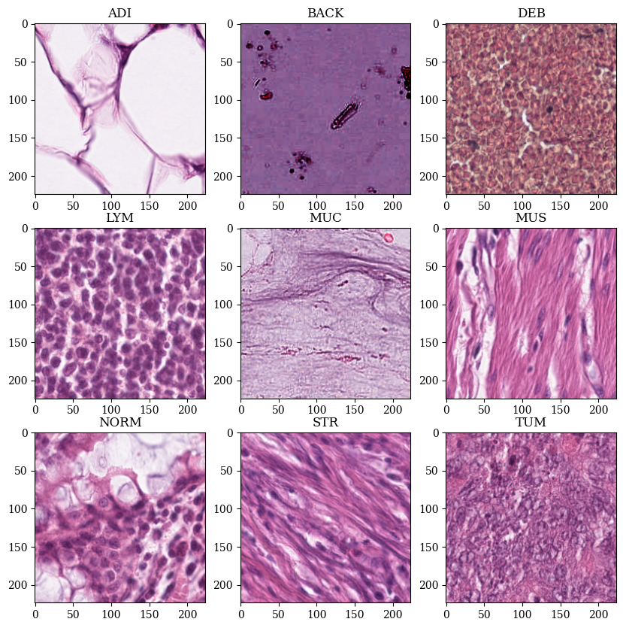
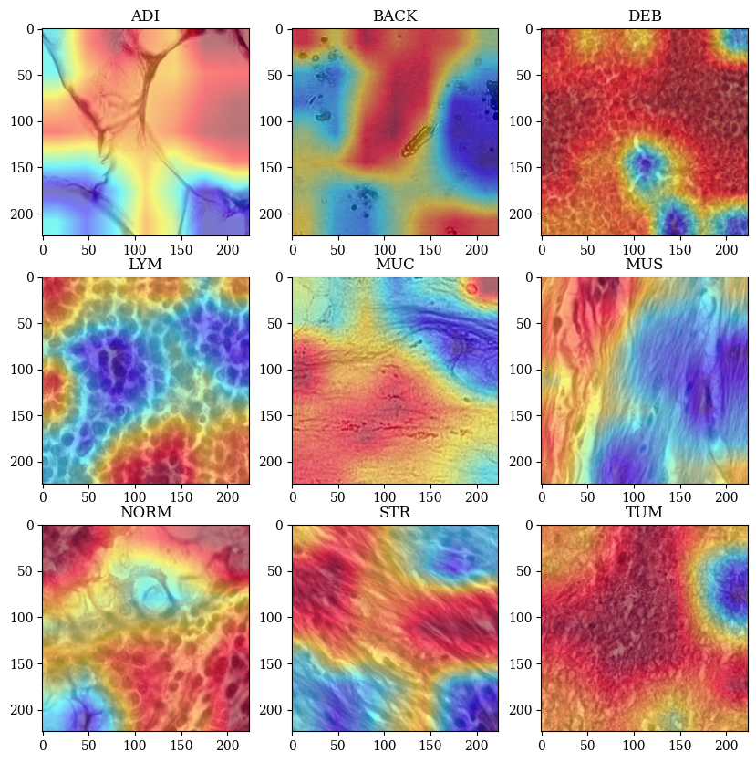
Tumor patches detection model visualization (9 different categories)

Slide 5
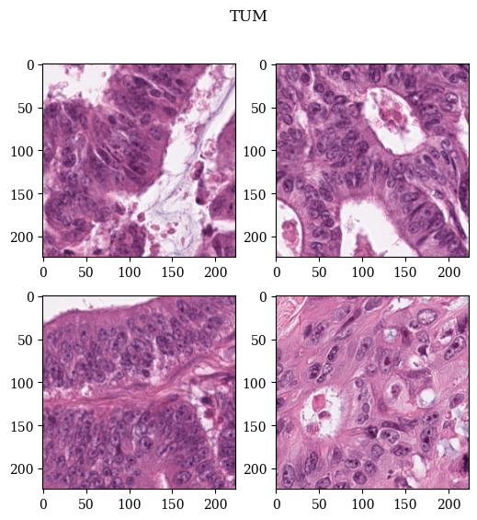
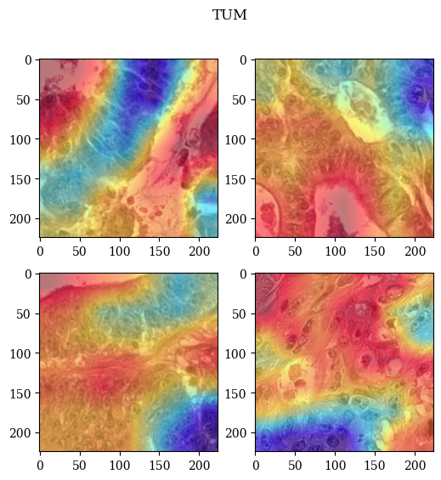
Tumor patches detection model visualization (colorectal adenocarcinoma epithelium)

Slide 6
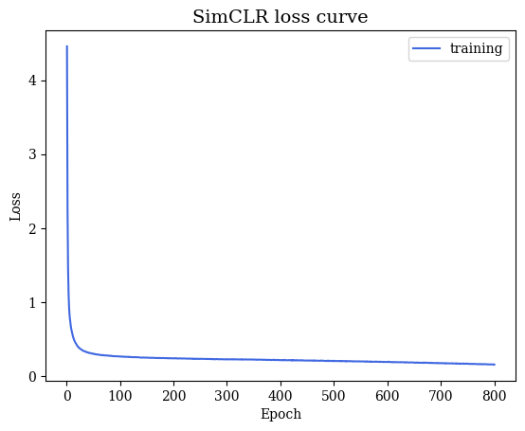
SimCLR (feature extractor) training result
The aim is training a specific CNN-based feature extractor to implement on TCGA-COAD tumor patch data.
- Epoch: 800
- Batch size: 256
- Optimizer: AdamW
- Backbone: ResNet50

Slide 7
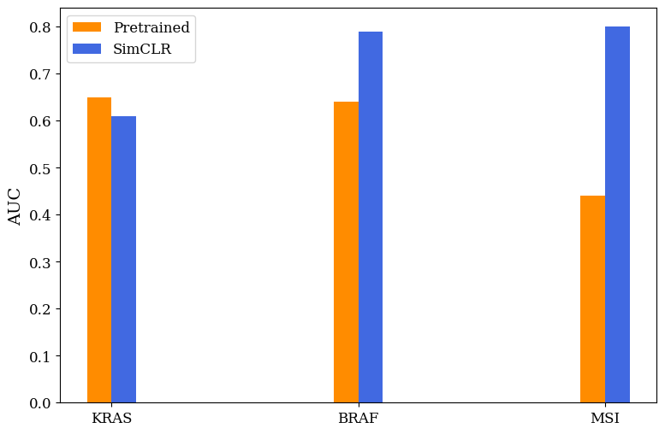
AttMIL prediction result (AUC)

Slide 8
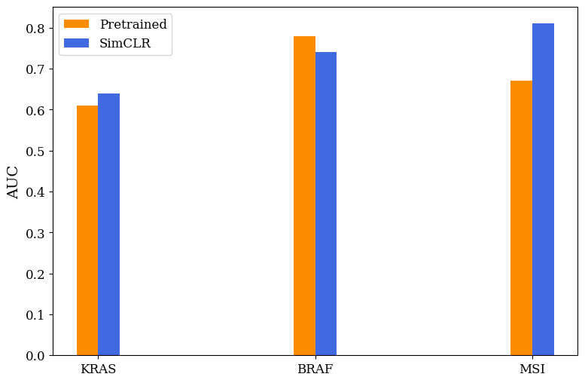
TransMIL prediction result (AUC)

Slide 9
Future work
1
Fine-tune Gnn model
2
Ensemble with attMIL, transMIL and Gnn
3
Keep predicting import biomarker of colorectal cancer

